Slide 1

S.K.Y RECORDS
ao
青
Final Milestone
LODISHEN NARAYANASAWMY
NANA AGYEMANG BOATENG
NEIL MAGAMBO

Slide 2


02
S.K.Y RECORDS
WHAT IS AO?
We’re creating a seamless mobile streaming music platform which hosts high-fidelity audio files and provides an intuitive interface for listeners and creators.

Slide 3
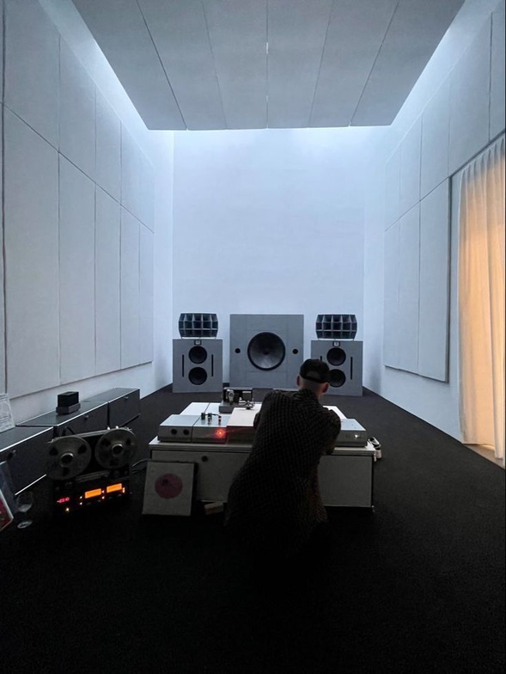
03
WORK PERFORMED
FIXING BUGS
SET UP ONLINE DATABASE
IMPLEMENT WITH ANDROID STUDIO
FUNCTIONALITIES
PRESENTATION

Slide 4
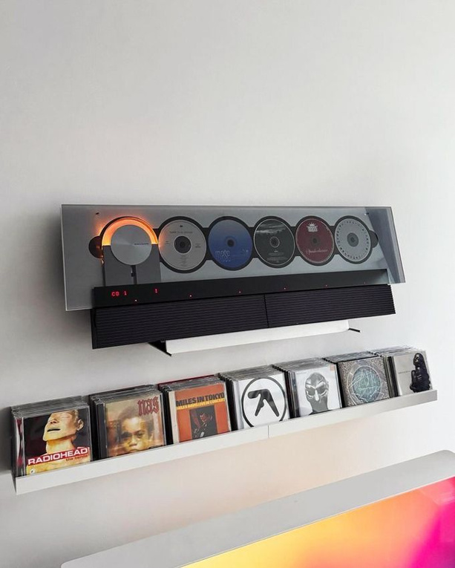
04
WHAT HAS GONE WELL
MAIN FUNCTIONS WORK!
UI LOOKS GOOD
SETTING UP THE DATABASE
LOOKING FOR RESOURCES (STACK EXCHANGE,KOTLIN FORUM )
CHALLENGES
FIXING BUGS
APP NOT RUNNING ON SOME LAPTOPS
IMPLEMENTATIONS AND DEPENDENCIES
20MINS LATE FOR EVERYONE

Slide 5

05
S.K.Y RECORDS
FUTURE PLANS (IF WE HAD MORE TIME)
POLISH THE UI
ADD A LOGIN PAGE FOR EACH INDIVIDUAL USER
ADD COVER ARTS
FURTHER FIX BUGS

Slide 6

06
S.K.Y RECORDS
CONCLUSION
We finally done
Fun project
Kotlin sucks!!!!!one!11!1!

Slide 7
S.K.Y RECORDS
THANK YOU
LODISHEN NARAYANASAWMY
NANA AGYEMANG BOATENG
NEIL MAGAMBO

